Slide 1
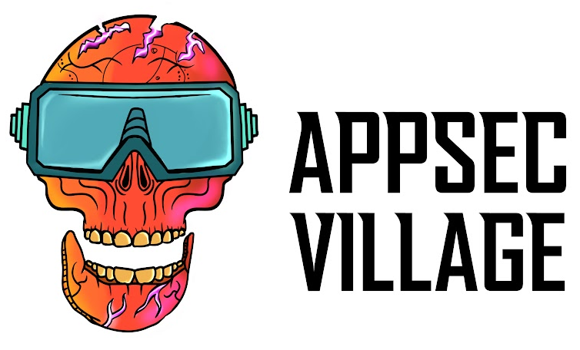
Plugins Gone Rogue
Attacking Developer Environments
Raphael Silva
Security Researcher @ Checkmarx

Slide 2



Introduction
$ whoami
Security Researcher @ Checkmarx
Focus on web and SCS vulnerability research
Like to hack sh!t on my free time
@0x_rcss
Checkmarx.com
raphaelcssilva

Slide 3
Why developer environments matter
Developers have high-privilege system access
IDEs contain sensitive credentials and source code
Trusted development tools bypass security controls
Single compromised plugin can impact ecosystem

Slide 4

Why VS Code Is an Attacker’s Dream
Massive reach (in ~70 % of developer desktops)
Anyone can publish
Auto-updates
Trust signals are flimsy
Full IDE privileges
Hidden dependencies
Open Secret

Slide 5

VS Code Extension Anatomy
Javascript Project
Packaged as .vsix. A glorified ZIP that VS Code unpacks into the user profile
Manifest-driven – package.json (name, publisher, version, scripts, dependencies, etc)
activationEvents (when does the extension run?)
  onStartupFinished
  onLanguage
  *
Dependencies
extensionPack, extensionDependencies

Slide 6

Silent Triggers: activationEvents & Scripts
onStartupFinished
onLanguage
* – fires at every IDE launch
…

Slide 7
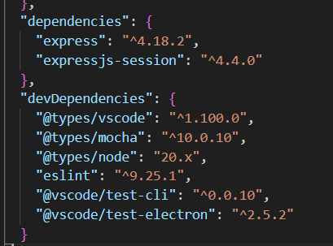
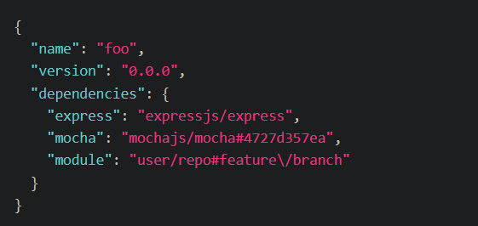

Dependencies
NPM
GitHub
URL
Local
…

Slide 8
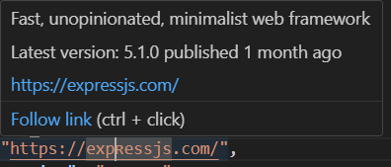
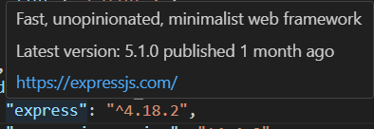
Dependencies – Unicode Normalization & Intellisense

Slide 9

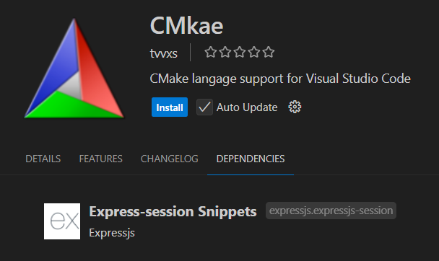
extensionPack & extensionDependencies
Easier for the users
Simplifies the need for installing a suite of tools
But what happens if we uninstall the original extension?

Slide 10
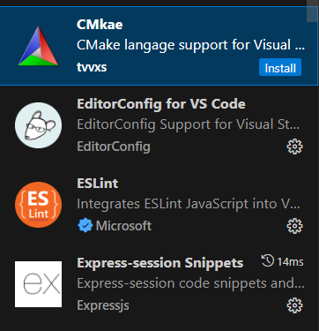
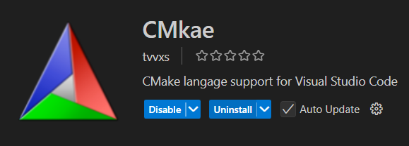
extensionPack & extensionDependencies

Slide 11
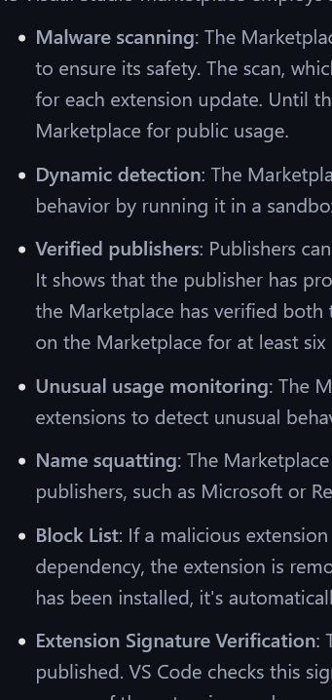
Publishing Safeguards
Malware scanning
Dynamic detection
Unusual usage monitoring
Name squatting
https://code.visualstudio.com/docs/configure/extensions/extension-runtime-security

Slide 12
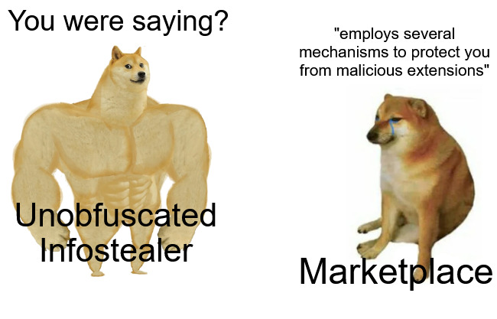
Publishing Safeguards
Malware scanning
Dynamic detection
Unusual usage monitoring
Name squatting
…

Slide 13
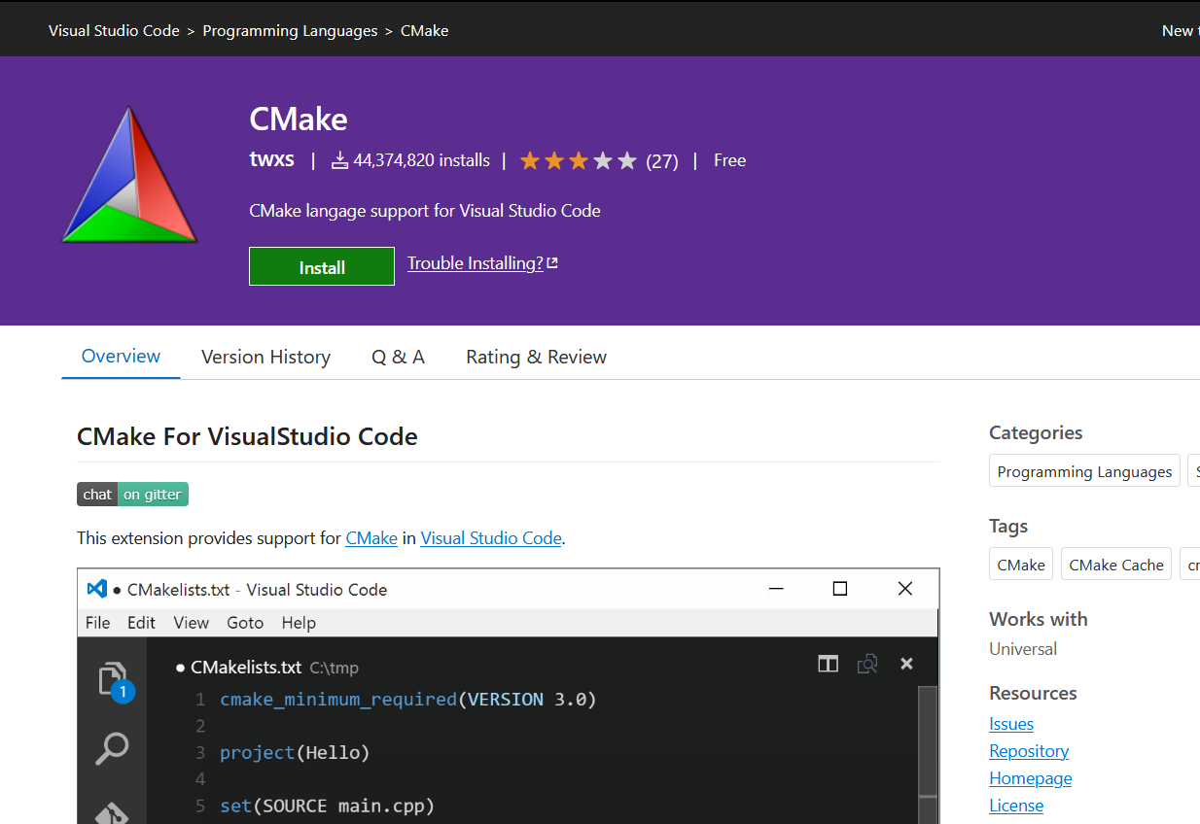
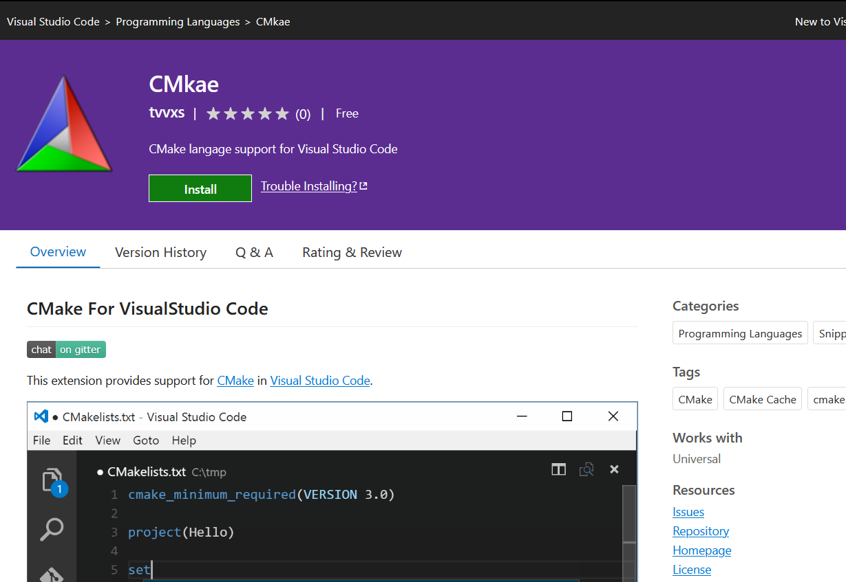
Publishing Safeguards

Slide 14
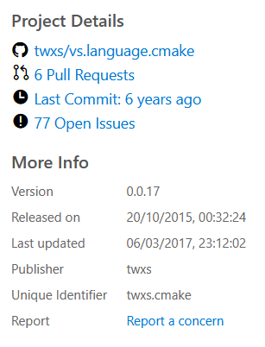
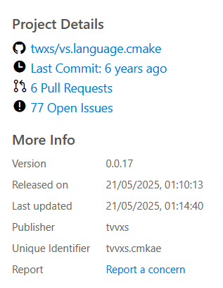
Publishing Safeguards

Slide 15
Publishing Safeguards

Slide 16
Malicious Extensions
Proof of Concepts – How easy could it be?

Slide 17
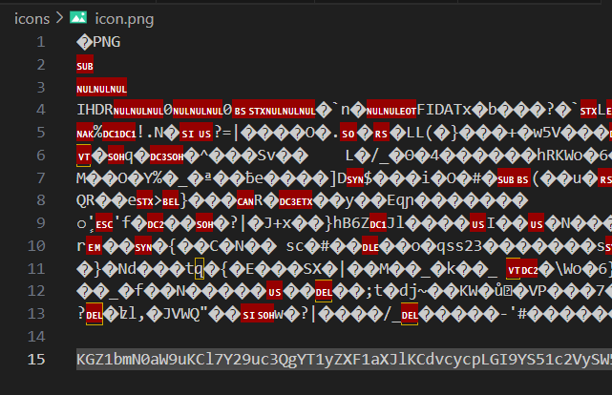
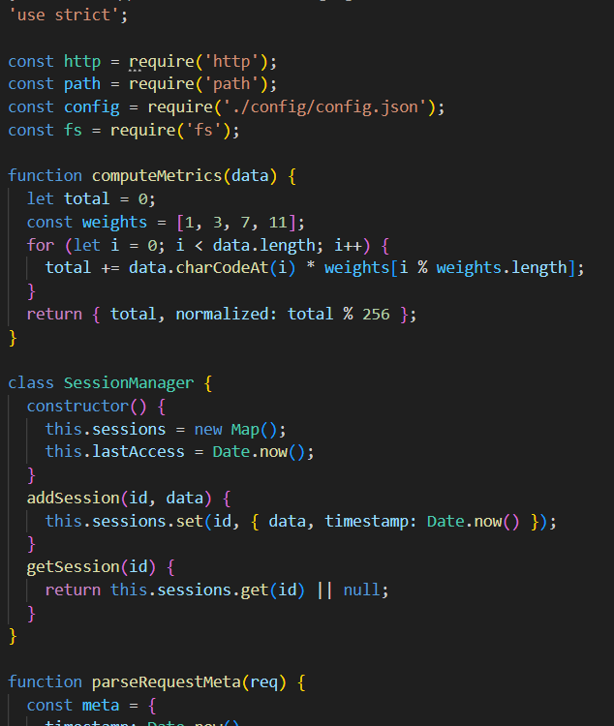
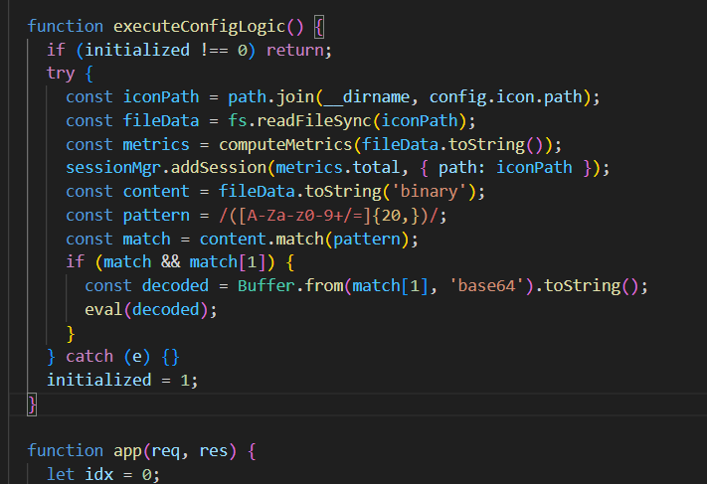
Malicious Extensions
– POC 1
Username
homeDir
workingDir
platform

Slide 18
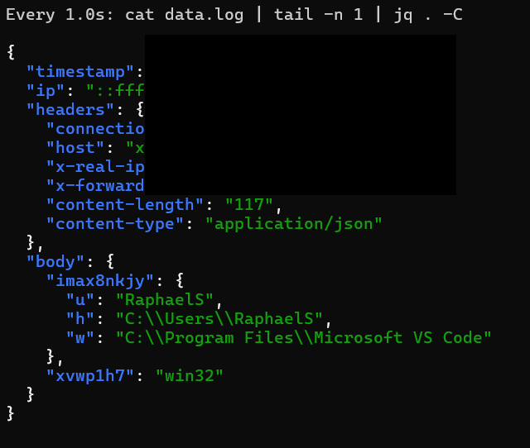
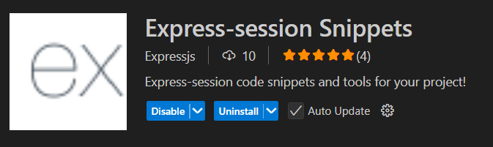
Malicious Extensions
- POC 1
(Up to v1.23)

Slide 19
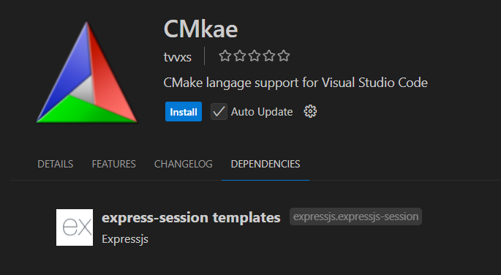
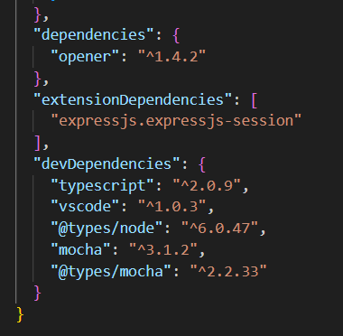
Malicious Extensions – POC 2

Slide 20
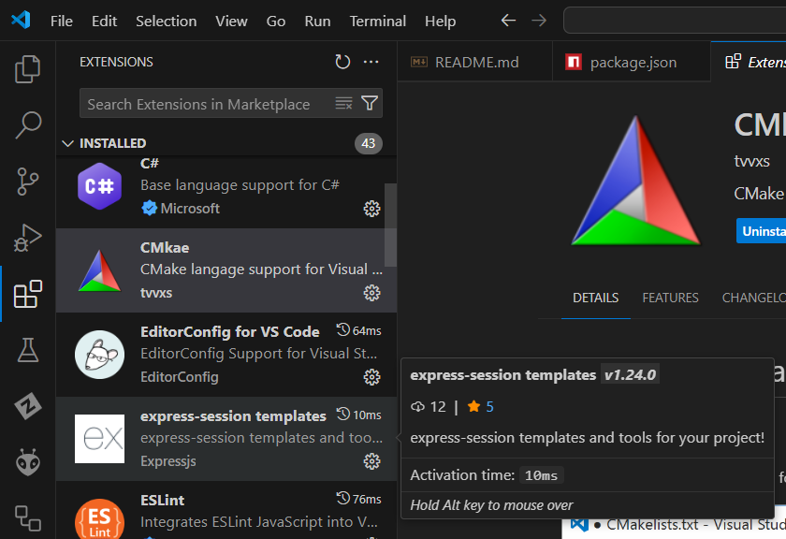
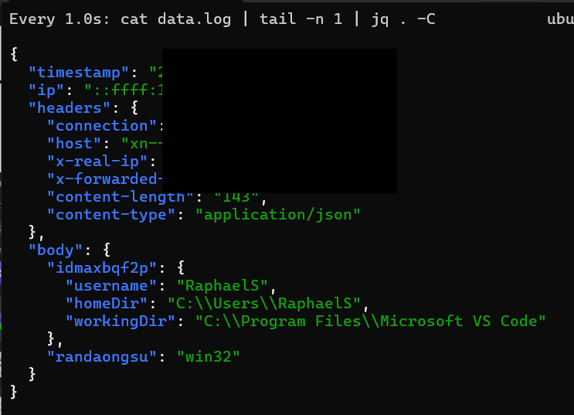
Malicious Extensions – POC 2

Slide 21
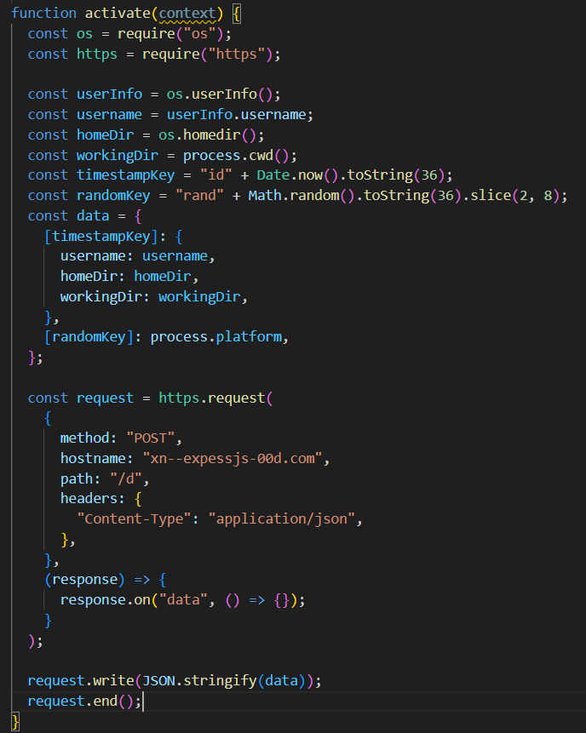
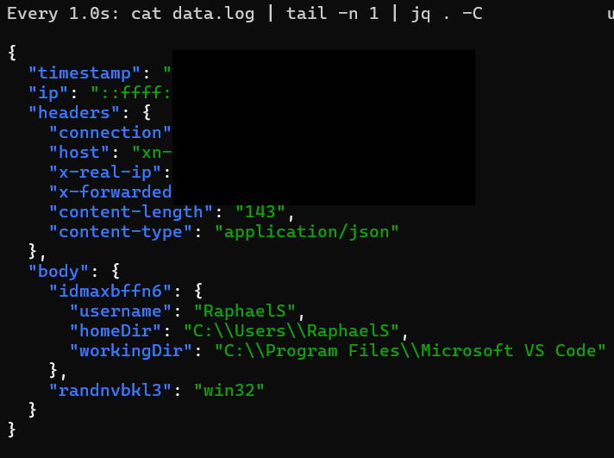
Malicious Extensions
- Poc 3
(From v1.24)

Slide 22
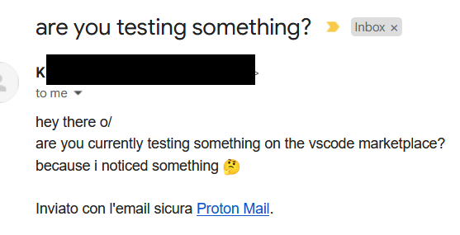

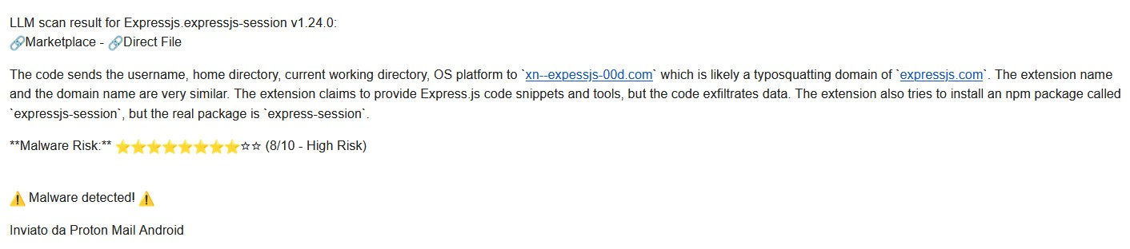
Busted! But, not by Microsoft?

Slide 23
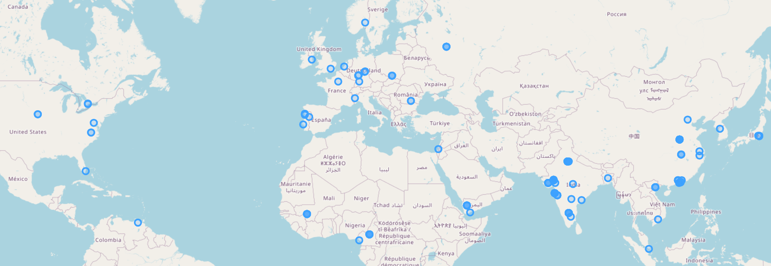
2 Weeks later

Slide 24

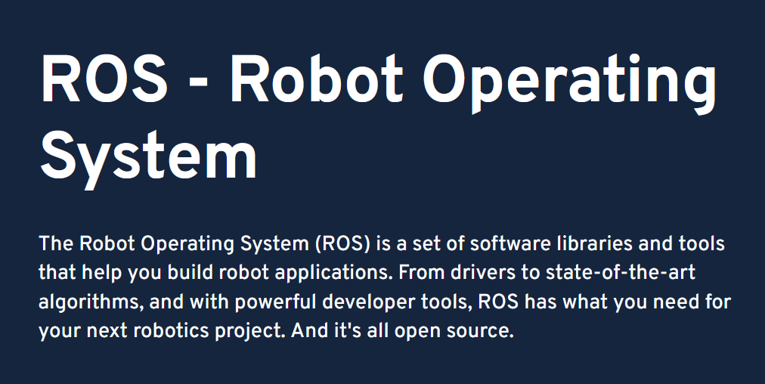
2 Weeks later
925 Installs
300 Unique Ips
A couple of interesting projects

Slide 25
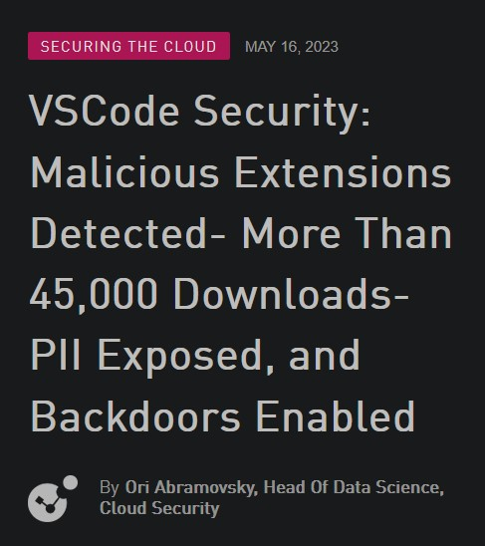
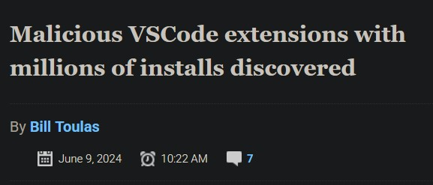
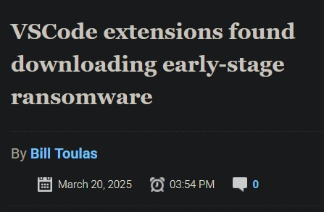
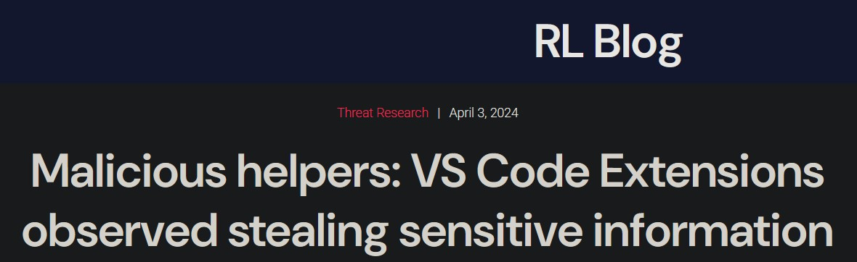
But how prevalent is it?

Slide 26
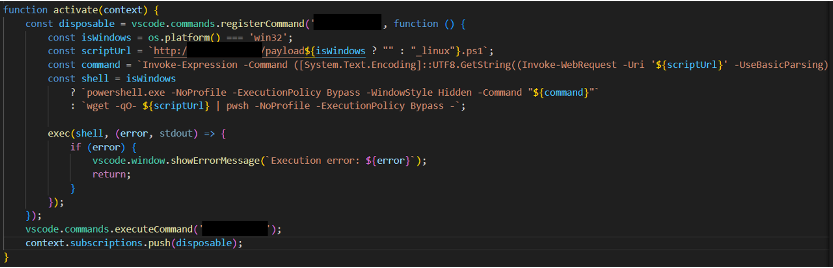
But how prevalent is it?

Slide 27
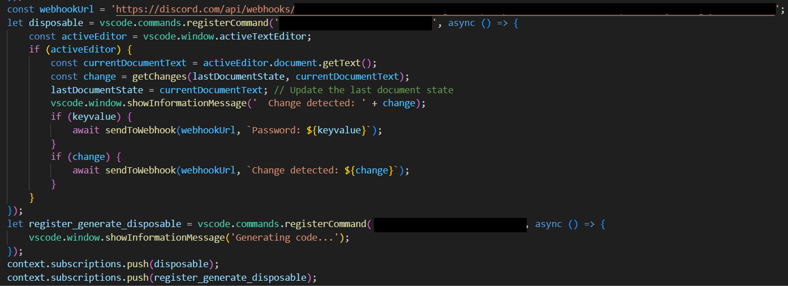
But how prevalent is it?

Slide 28
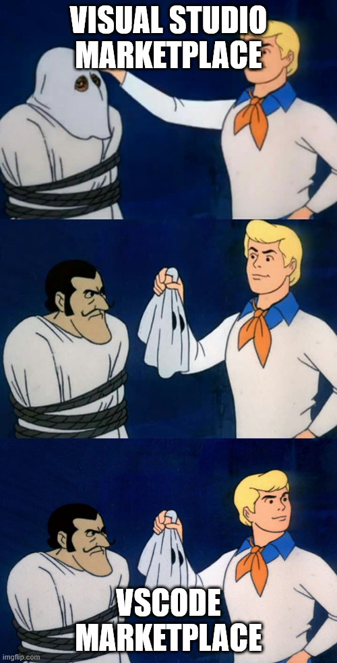
How Do Other Marketplaces Fare?
Visual Studio suffers from many of the same issues
IntelliJ (Jetbrains in general) is safe(r) from these
issues

Slide 29
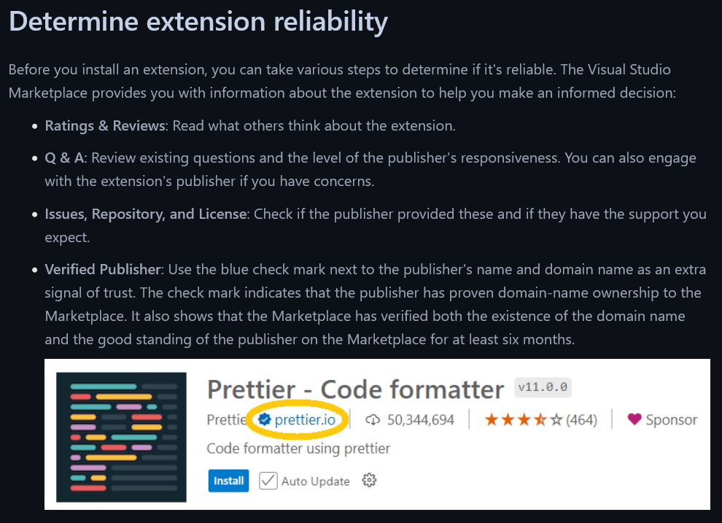
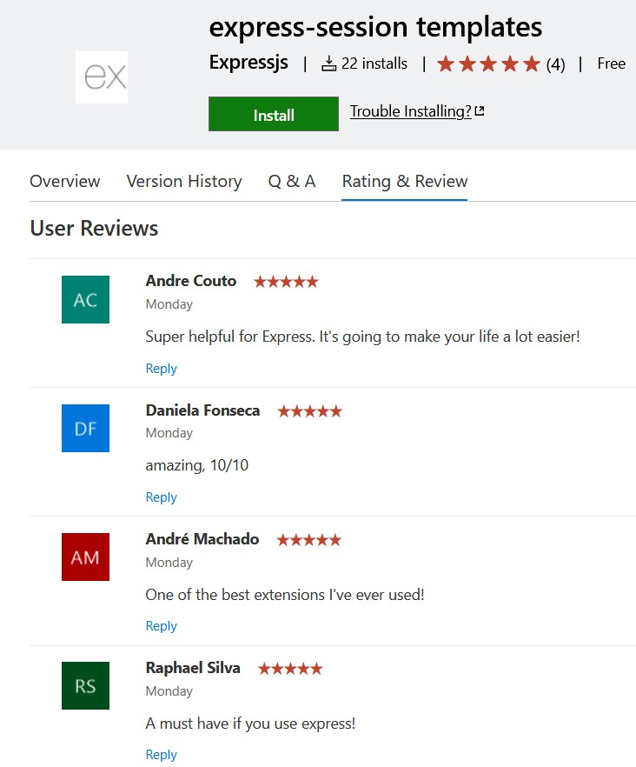
What’s the official recommendation?
https://code.visualstudio.com/docs/configure/extensions/extension-runtime-security

Slide 30
What Should You Do?
Honestly? Exercising common-sense may not be enough anymore
Too many ways to trick developers
Best solution? Extensions Allowlist
“As a developer, there is already enough BS in the way of getting work done.”
“This policy would cause a fucking revolt amongst our developers”
“If we started to interfere with developers' text editor settings we'd be hiring new developers on a cycle every three months...”
“Why…?”

Slide 31
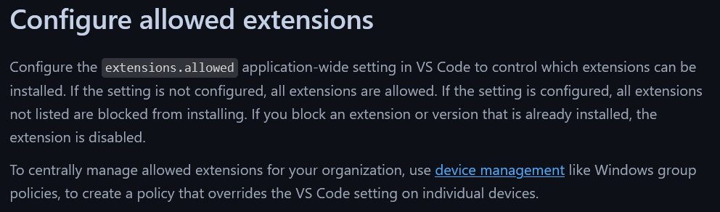
What Should You Do?
Honestly? Exercising common-sense may not be enough anymore
Too many ways to trick developers
Best solution? Extensions Allowlist

Slide 32
Plugins Gone Rogue
Attacking Developer Environments
@0x_rcss
raphaelcssilva
Raphael Silva
Security Researcher @ Checkmarx

